Slide 1




MOVIE STUDIO
INVESTMENT STRATEGY
Jeesoo Jhun
Flatiron Studio

Slide 2
OVERVIEW
Business Problem
Data Understanding
Key Findings
Recommendations
Next Steps

Slide 3

BUSINESS PROBLEM
Genres
Budget
Runtime

Slide 4
DATA UNDERSTANDING
Kaggle
Movie genres
Budgets
Ratings
IM.DB
Runtime
Revenue

Slide 5
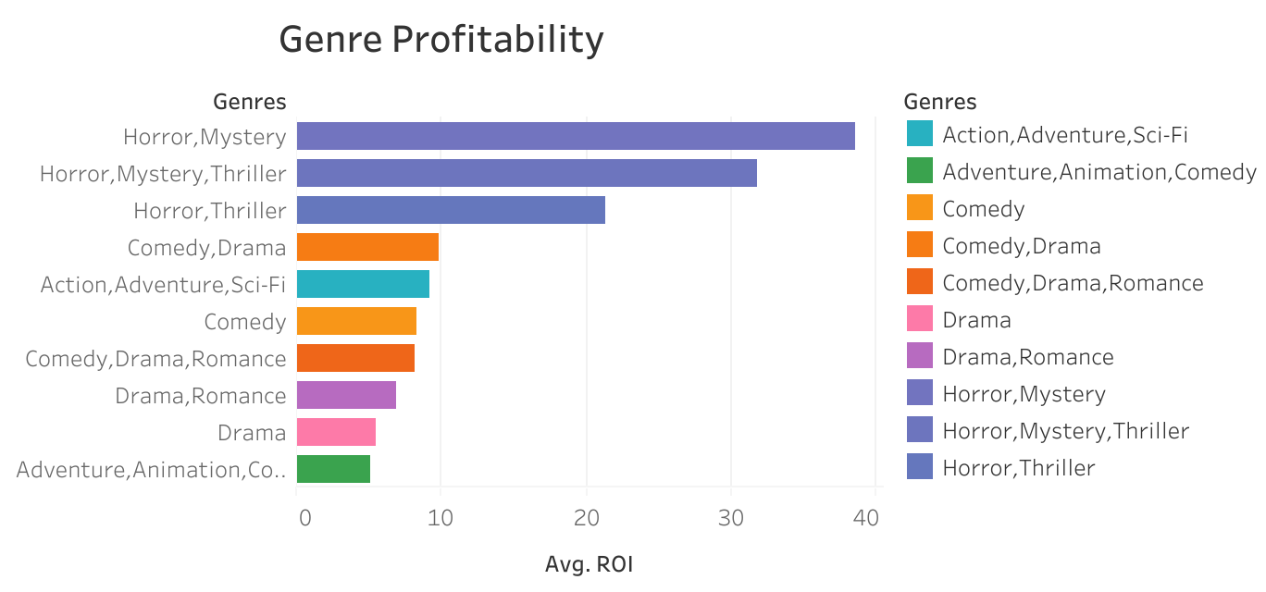
Which Genres Are Most Profitable-1?
Horror
Mystery
Thriller

Slide 6
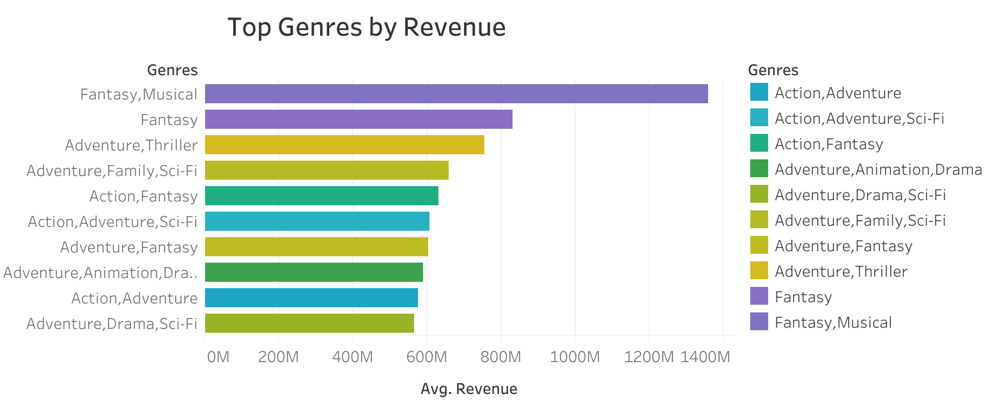
Which Genres Are Most Profitable-2?
Fantasy
Adventure
Action
Sci-Fi

Slide 7
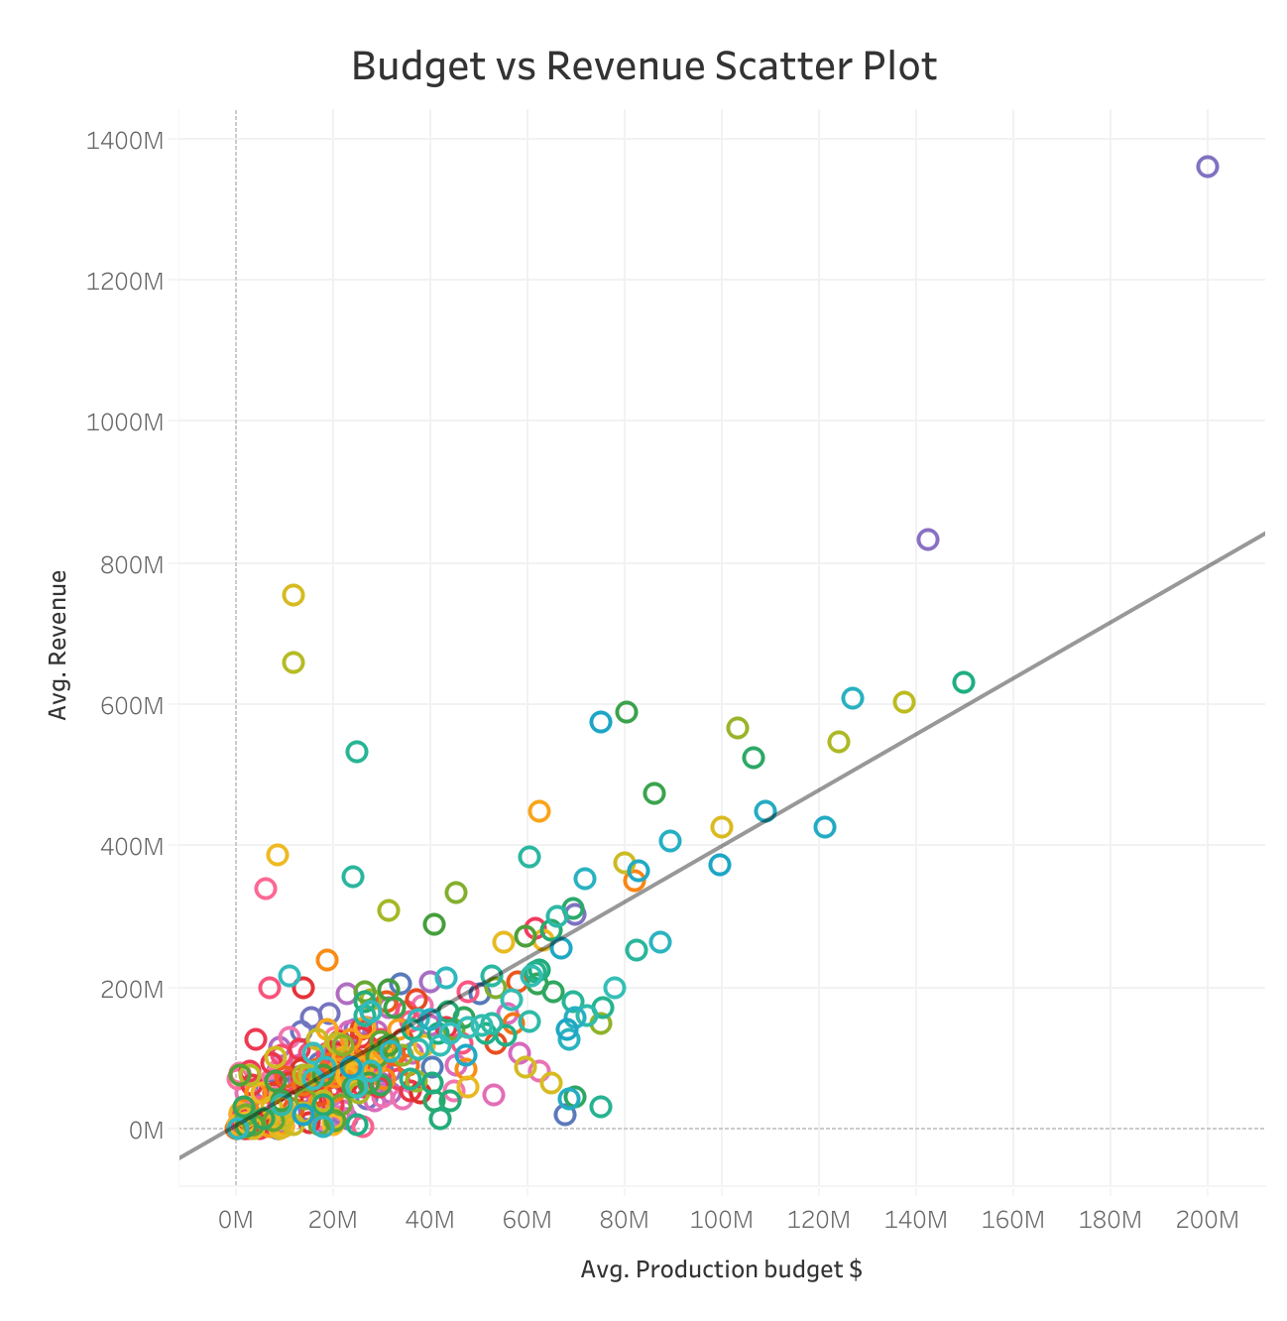
How Do Production Budgets Impact Success?
Production budgets ↑ → Revenue ↑

Slide 8
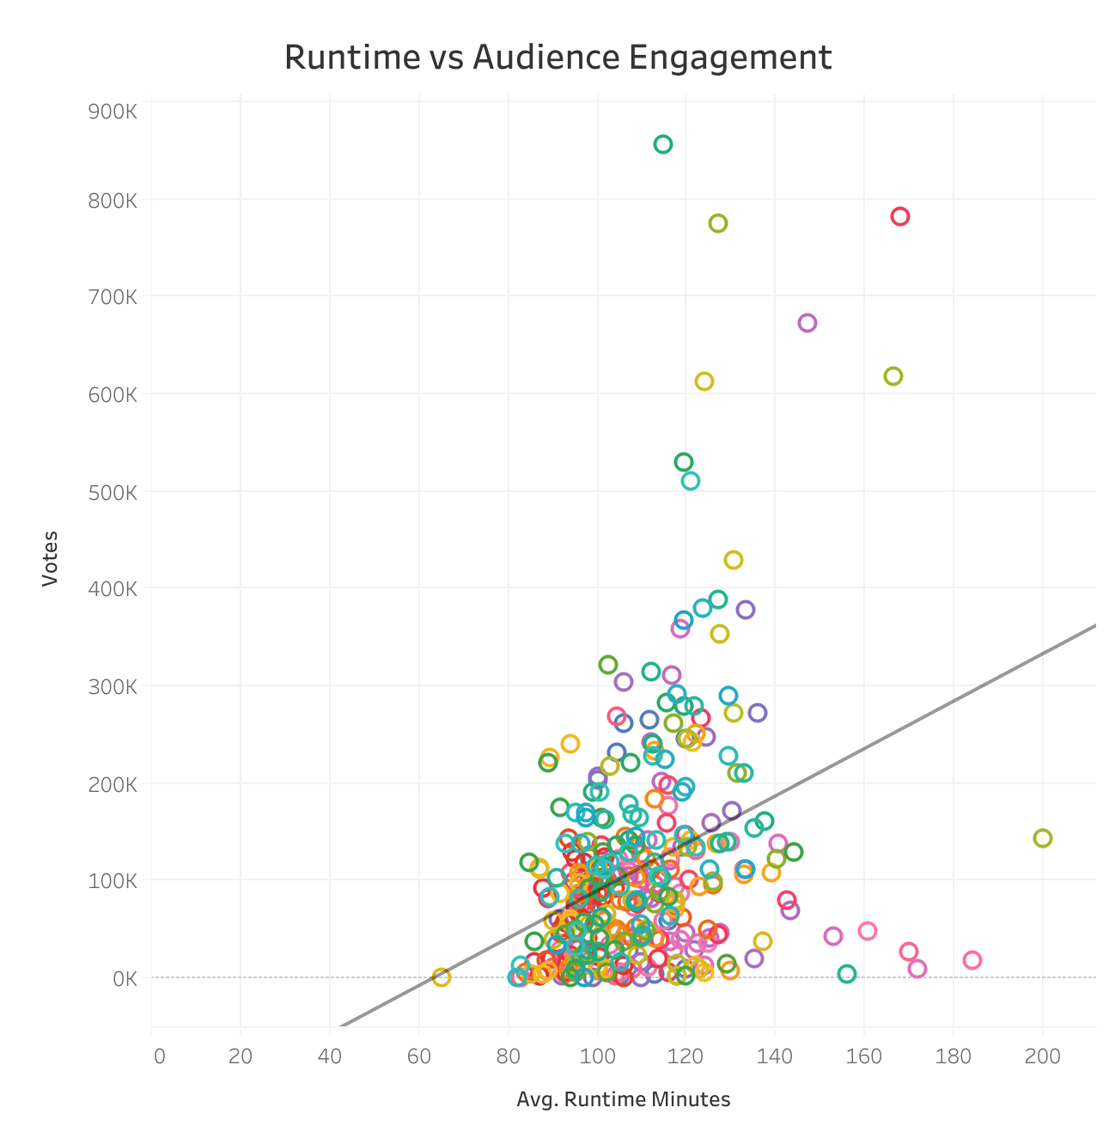
How Does Runtime Affect Success and Engagement?
1. Longer Movies → More Engagement
2. 90 ~120 min

Slide 9
RECOMMENDATIONS
ROI : Horror & Thriller
Revenue : Action & Sci-Fi
Production Budget : Mixed
Runtime : 90-120 mins

Slide 10



NEXT STEPS

Slide 11




THANK YOU
Presented by: Jee Soo Jhun
jeesoo@flatiron.com

